Slide 1



YOUTUBE DATABASE MANAGEMENT SYSTEM
SUBMITTED BY:-
AAROH SRIVASTAVA(2021BCS-001)
ANKIT SANKHYAN(2021BCS-013)
ANSHU JOSHI(2021BCS-014)
HARI OM SHARMA(2021BCS-029)
NIKHIL DIXIT(2021BCS-050)
PRASUN MONDAL(2021BCS-054)
SUBMITTED TO :-
DR. DEBANJAN SADHYA

Slide 2
OVERVIEW
WHY DO WE NEED YOUTUBE MANAGEMENT SYSTEM?
1. Improved data sharing and data security.
2. Effective data integration
3. Consistent, reliable data
4. Data that complies with privacy regulations
5. Increased productivity
6. Better decision-making

Slide 3
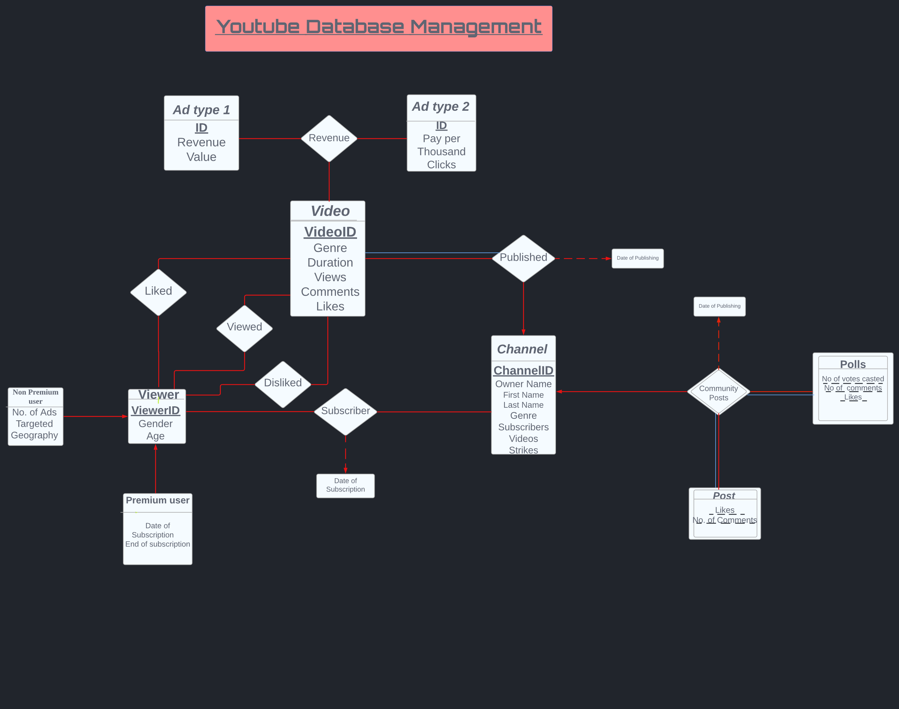
ER DIAGRAM

Slide 4
ENTITY SETS
Video :
(VideoID, Genre, Duration, Views, Comments, Likes)
Here , VideoID is the Primary Key and other attributes are giving detailed information about a particular video.
Ad type 2
(ID, Pay per Thousand Clicks)
Ad type 1
(ID, Revenue Value)
Viewer
Premium User(date of subscription , end of subscription )
Non Premium User(Geography,NoOfAdsTargetted)
(Viewer ID , Gender , Age)
Channel :
(ChannelID, OwnerName(First Name, Last Name), Genre, Subscribers, Videos, Strikes)
Where ChannelID is a Candidate key, hence it can’t be ‘NULL’ and is always unique. OwnerName is a composite attribute whose components are FirstName and LastName. All other attributes are giving detailed information about the channel.
Polls(Weak Set) :
(NumberOfVotesCasted, NumberOfComments, Likes)
Post(Weak Set) :
o (Likes,No. of comments)

Slide 5
RELATIONSHIP AND MAPPING CARDINALITY:
1. Subscribed:
(ViewerID, ChannelID,DateOfSubscripti)
‘Subscribed’ is a Many to Many relationship from Viewer to Channel as one viewer can subscribe to many channels and one channel can be subscribed by many viewers. Since it is a Many to Many relationship , the Primary key of the relationship set includes the primary key of both viewer and channel. There is a Partial participation from both viewer and channel side as it may happen that a viewer has not subscribed to any channel and it also may happen that a channel has no subscribers.
2. Published:
(VideoID, ChannelID, DateOfPublishing)
‘Published’ is a One to Many relationship from Channel to Video as one channel can publish many videos but one video cannot belong to many channels. Since it is a One to Many relationship from Channel to Video so , the Primary key of the relationship set Published has the primary key of Video only as it is on many side. There is a Total participation from video side and Partial participation from channel side as every video present is published by some channel but it may happen that a channel has not published any video. The attribute DateOfPublishing is giving information about when the video was published.
3. Liked:
(ViewerID, VideoID)
‘Liked’ is a Many to Many relationship from Viewer to Video as one viewer can like many videos and one video can be liked by many viewers. Since it is a Many to Many relationship, the Primary key of Liked set will include both primary keys of Viewer and Video. There is a partial participation from both side as it is possible that a viewer may not like any video and a video may not be liked by any viewer.

Slide 6
4. Disliked:
(ViewerID, VideoID)
‘Disliked’ is a Many to Many relationship from Viewer to Video as one viewer can dislike many videos and one video can be disliked by many viewers. Since it is a Many to Many relationship, the Primary key of Disliked set will include both primary keys of Viewer and Video. There is a partial participation from both side as it is possible that a viewer may not dislike any video and a video may not be disliked by any viewer.
5. Viewed:
(ViewerID, VideoID)
‘Viewed’ is a Many to Many relationship from Viewer to Video as one viewer can view many videos and one video can be viewed by many viewers. Since it is a Many to Many relationship, the Primary key of the Viewed set will include both primary keys of Viewer and Video. There is partial participation from both sides as it is possible that a viewer may not view any video and a video may not be viewed by any viewer.
6. Community Posts:
(DateofPublishing )
‘Community Posts’ is a Many to One and Ternary relationship from Polls and Post to Channel as one channel can have many number of polls and posts but each post and poll can belong to one channel only. Since Polls and Post are Weak Entity Sets, hence the Primary key of Community Posts set will include only it's own attribute. There is a total participation from Polls and Post sets both as they are Weak Entity Sets. Community Posts is an Identifying Relationship.

Slide 7
7. Revenue:
( VideoID,Adtype1.ID,Adtype2.ID)
‘Revenue’ is a Many to Many and Ternary relationship from Video to Ad type 1 and Ad type 2 as one video can have many number of both types of ads and either ad can run in many videos. Since it is a Many to Many relationship, the Primary key of Revenue set will include primary keys of Ad type 1, Ad type 2 and Video entities. There is a partial participation from both side as it is possible that a video may not generate any revenue and an ad may not be played in any video.

Slide 8
CONVERTING ER DIAGRAM TO SCHEMAS AND REMOVING REDUNDANCIES:
1.VIDEO AND CHANNEL:
It is a many to one relationship and it is total on the many side thus we can add primary key of the channel entity to the video entity and remove the schema for relationship “published”. Thus, we will obtain 2 tables.
Video(VideoID,ChannelID,DateOfPublishing,Genre,Duration,Views,Comments, Likes)
Channel(ChannelID,OwnerName(First Name,Last Name),Genre,Subscribers,Videos,Strikes)
2.POST AND CHANNEL:
It is a many to one relationship and it is total on the many side thus we can add primary key of the channel entity can be added to the post entity and remove the schema for relationship “community posts”. Thus, we will obtain 2 tables. Primary key of the channel entity can be added to the polls entity and remove the schema for relationship thus we will obtain 2 tables.
Moreover polls is a weak set.
Moreover post is a weak set.
Post(ChannelID,likes,NoOfComments,DateOfPublishing)
Channel(ChannelID,OwnerName(First Name,Last Name),Genre,Subscribers,Videos,Strikes)
3.POLLS AND CHANNEL:
It is a many to one relationship and it is total on the many side. So we can add primary key of the one side to the many side of the table
Polls(ChannelID,DateOfPublishing,NumberOfVotesCasted,NumberOfComments,Likes)
Channel(ChannelID,OwnerName(First Name,Last Name),Genre,Subscribers,Videos,Strikes)

Slide 9

4.PREMIUM USER,NON PREMIUM USER AND VIEWER
Premium user and Non Premium user entities are the examples of the specialization.
Thus the table of the Premium user will be
PremiumUser(ViewerID,DateOfSubscription,EndOfSubscription)
Similarly the table of the Non Premium user will be:
NonPremiumUser(ViewereID,Geography,NoOfAdsTargetted)
The table of the Viewer will be:
Viewer(ViewerID,Gender,Age)
5.LIKED:
It will have VideoID and ViewerID as it’s attributes.
Liked(VideoID,ViewerID)
6.DISLIKED:
It will have VideoID and ViewerID as it’s attributes.
Disliked(VideoID,ViewerID)
7.VIEWED:
It will have VideoID and ViewerID as it’s attributes.
Viewed(VideoID,ViewerID)
8.SUBSCRIBER:
Subscriber(ViewerID,ChannelID, DateOfSubscription)

Slide 10
9.AD_TYPE1:
Ad_type1(ID,Revenue_Value)
10. AD_TYPE2:
Ad_type2(ID,PayperThousandClicks)
11.REVENUE:
Revenue(VideoID,Ad_type1.ID,Ad_type2.ID)

Slide 11

FUNCTIONAL DEPENDENCIES IN THE TABLES:
1.
Video(VideoID,ChannelID,DateOfPublishing,Genre,Duration,Views,Comments, Likes)
VideoID->ChannelID,DateOfPublishing,Genre,Duration,Views,Comments, Likes)
Assumption: Channel ID will contain the information about the genre of the channel.
ChannelID->Genre
2.
Channel(ChannelID,OwnerName(First Name,Last Name),Genre,Subscribers,Videos,Strikes)
ChannelID->OwnerName(First Name,LastName),Genre,Subscribers,Videos,Strikes
3.
Post(ChannelID,likes,NoOfComments,DateOfPublishing)
ChannelID,DateOfPublishing->likes,NoOfComments
Assumption: There is a specific ratio of likes to No of comments thus,
likes->NoOfComments but not NoOfComments->Likes
4.
Polls(ChannelID,DateOfPublishing,NumberOfVotesCasted,NumberOfComments,Likes)
ChannelID,DateOfPublishing->NumberOfVotesCasted,NumberOfComments,Likes
5.
PremiumUser(ViewerID,DateOfSubscription,EndOfSubscription)
ViewereID->DateOfSubscription,EndOfSubscription

Slide 12

6.)
NonPremiumUser(ViewerID,Geography,NoOfAdsTargetted)
ViewerID,Geography->NoOfAdsTargetted
Assumption: No of targeted ads will determine the geography. Thus,
NoOfAdsTargetted->Geography
7.)
Viewer(ViewerID,Gender,Age)
ViewerID->Gender,Age
8.)
Liked(VideoID,ViewerID)
VideoID,ViewerID->VideoID,ViewerID
9.)
Disliked(VideoID,ViewerID)
VideoID,ViewerID->VideoID,ViewerID
10.)
Viewed(VideoID,ViewerID)
11.)
Subscriber(VideoID,ViewerID, DateOfSubscription)
VideoID,ViewerID->DateOfSubscription

Slide 13
12.)
Ad_type1(ID,RevenueValue)
ID->RevenueValue
13.)
Ad_type2(ID,PayperThousandClicks)
ID->PayperThousandClicks
14.)
Revenue(Ad_type1.ID ,Ad_type2.ID, VideoID)
VideoID->Ad_type1,Ad_type2

Slide 14
DECOMPOSITION (USING NORMALIZATION) :
1.
Video(VideoID,ChannelID,DateOfPublishing,Genre,Duration,Views,Comments, Likes)
1NF: Assuming that every attribute is atomic we can say that the given schema is in 1NF.
2NF: Since there is only one attribute in the primary key, thus we can say that there can be no partial dependency. Hence the schema is in 2NF.
3NF:VideoID->ChannelID and ChannelID->Genre we can say that VideoID->Genre, thus transitivity exists and the above schema is not in 3NF.
We will break it into two schemas namely
Video1(VideoID,ChannelID,DateOfPublishing,Duration,Views,Comments, Likes)
Video2(ChannelID,Genre)
BCNF: VideoID->ChannelID,DateOfPublishing,Duration,Views,Comments, Likes
But VideoID is the superkey. Thus, the above schema is in BCNF.

Slide 15
DECOMPOSITION (USING NORMALIZATION) :
2.
Channel(ChannelID,OwnerName(First Name,Last Name),Genre,Subscribers,Videos,Strikes)
1NF: Assuming that every attribute is atomic we can say that the given schema is in 1NF.
2NF: Since there is only one attribute in the primary key, thus we can say that there can be no partial dependency. Hence the schema is in 2NF.
3NF: Since there is only 1 functional dependency in the schema thus we can say that it will be in 3NF.
BCNF: Since,
ChannelID->OwnerName(First Name,LastName),Genre,Subscribers,Videos,Strikes
But we know that ChannelID is the super key, thus we can say that the above schema is in BCNF.

Slide 16
DECOMPOSITION (USING NORMALIZATION) :
3.
Post(ChannelID,likes,NoOfComments,DateOfPublishing)
1NF : Assuming that every attribute is atomic we can say that the given schema is in 1NF.
2NF: Since the proper subset of the primary key is not determining any of the attributes thus we can say that the above schema is in 2NF.
3NF:ChannelID,DateOfPublishing->likes,comments
And likes->comments
Thus, by transitivity ChannelID,DateOfPublishing->comments
Now, decomposing
Post1(ChannelID,DateOfPublishing,likes)
Post2(Likes,Comments)
BCNF: Clearly the above schema is in BCNF because no key other than primary key is determining anything.

Slide 17
DECOMPOSITION (USING NORMALIZATION) :
4.
Polls(ChannelID,DateOfPublishing,NumberOfVotesCasted,NumberOfComments)
1NF : Assuming that every attribute is atomic we can say that the given schema is in 1NF.
2NF: 2NF: Since the proper subset of the primary key is not determining any of the attribute thus we can say that the above schema is in 2NF.
3NF: Since there is no other functional dependency of the forms a->b and b->c thus, the schema is in 3NF.
BCNF: Since, in functional dependency all the things present on the left hand side is the super key thus the schema is in BCNF form.
5.
PremiumUser(ViewerID,DateOfSubscription,EndOfSubscription)
1NF : Assuming that every attribute is atomic we can say that the given schema is in 1NF.
2NF: Since there is only one attribute in primary key, thus we can say that there can be no partial dependency. Hence the schema is in 2NF.
3NF: Since there is no other functional dependency of the forms a->b and b->c thus, the schema is in 3NF.
BCNF: Since, in functional dependency all the things present on the left hand side is the super key thus the schema is in BCNF form.

Slide 18
DECOMPOSITION (USING NORMALIZATION) :
6.
NonPremiumUser(ViewerID,Geography,NoOfAdsTargetted)
1NF : Assuming that every attribute is atomic we can say that the given schema is in 1NF.
2NF: Since the proper subset of the primary key is not determining any of the attribute thus we can say that the above schema is in 2NF.
3NF: Since a non primary attribute is not transitively related to the primary key attributes thus, the given schema is in 3NF.
BCNF: Since NoOfAdsTargetted is determining the Geography which is non trivial and NoOfAds is not the super key thus we can say that the above schema is not in BCNF.
We will decompose it into:
NonPremiumUser1(NoOfAdsTargetted,Geography)
NonPremiumUser2(ViewerID, NoOfAdsTargetted)

Slide 19
DECOMPOSITION (USING NORMALIZATION) :
7.
Viewer(ViewerID,Gender,Age)
1NF : Assuming that every attribute is atomic we can say that the given schema is in 1NF.
2NF: Since there is only one attribute in the primary key, thus we can say that there can be no partial dependency. Hence the schema is in 2NF.
3NF: Since there is no other functional dependency of the forms a->b and b->c thus, the schema is in 3NF.
BCNF: Since, in functional dependency all the things present on the left hand side is the super key thus the schema is in BCNF form
8.
Liked(VideoID,ViewerID)
1NF : Assuming that every attribute is atomic we can say that the given schema is in 1NF.
2NF: Since the proper subset of the primary key is not determining any of the attributes thus we can say that the above schema is in 2NF.
3NF: Clearly there are no transitive dependencies, the schema is in 3NF.
BCNF: Since only trivial dependencies exist thus, our schema is in BCNF. And in every dependency alpha is the super key.

Slide 20
DECOMPOSITION (USING NORMALIZATION) :
9.
Disliked(VideoID,ViewerID)
1NF : Assuming that every attribute is atomic we can say that the given schema is in 1NF.
2NF: Since the proper subset of the primary key is not determining any of the attributes thus we can say that the above schema is in 2NF.
3NF: Clearly there are no transitive dependencies, the schema is in 3NF.
BCNF: Since only trivial dependencies exist thus, our schema is in BCNF. And in every dependency alpha is the super key.
10.
Viewed(VideoID,ViewerID)
1NF : Assuming that every attribute is atomic we can say that the given schema is in 1NF.
2NF: Since the proper subset of the primary key is not determining any of the attributes thus we can say that the above schema is in 2NF.
3NF: Clearly there are no transitive dependencies, the schema is in 3NF.
BCNF: Since only trivial dependencies exists thus, our schema is in BCNF. And in every dependency alpha is the super key.

Slide 21
DECOMPOSITION (USING NORMALIZATION) :
11.
Subscriber(VideoID, ViewerID, DateOfSubscription)
1NF : Assuming that every attribute is atomic we can say that the given schema is in 1NF.
2NF: Since the proper subset of the primary key is not determining any of the attributes thus we can say that the above schema is in 2NF.
3NF: Clearly there are no transitive dependencies, the schema is in 3NF.
BCNF: Since only trivial dependencies exist thus, our schema is in BCNF. And in every dependency alpha is the super key.
12.
Ad_type1(ID,RevenueValue)
1NF : Assuming that every attribute is atomic we can say that the given schema is in 1NF.
2NF: Since the proper subset of the primary key is not determining any of the attributes thus we can say that the above schema is in 2NF.
3NF: Clearly there are no transitive dependencies, the schema is in 3NF.
BCNF: Since only trivial dependencies exist thus, our schema is in BCNF. And in every dependency alpha is the super key.

Slide 22
DECOMPOSITION (USING NORMALIZATION) :
13.
Ad_type2(ID,PayperThousandClicks)
1NF : Assuming that every attribute is atomic we can say that the given schema is in 1NF.
2NF: Since the proper subset of the primary key is not determining any of the attributes thus we can say that the above schema is in 2NF.
3NF: Clearly there are no transitive dependencies, the schema is in 3NF.
BCNF: Since only trivial dependencies exist thus, our schema is in BCNF. And in every dependency alpha is the super key.
14.
Revenue(Ad_type1.ID,Ad_type2.ID,VideoID)
1NF : Assuming that every attribute is atomic we can say that the given schema is in 1NF.
2NF: Since the proper subset of the primary key is not determining any of the attributes thus we can say that the above schema is in 2NF.
3NF: Clearly there are no transitive dependencies, the schema is in 3NF.
BCNF: Since only trivial dependencies exist thus, our schema is in BCNF. And in every dependency alpha is the super key.

Slide 23
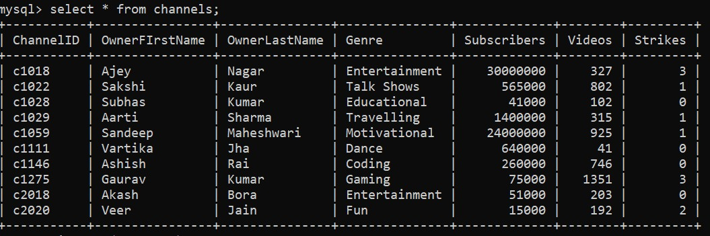
SQL SCHEMAS
Channel

Slide 24
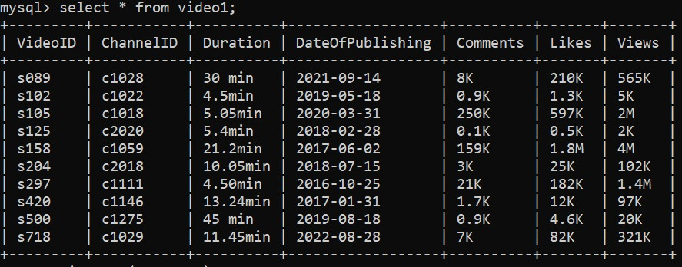
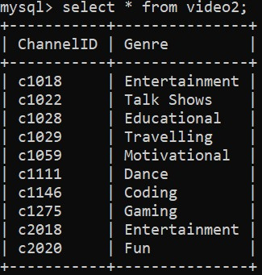
SQL SCHEMAS
video 2
video 1

Slide 25
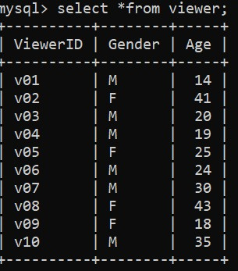
SQL SCHEMAS
Viewer

Slide 26
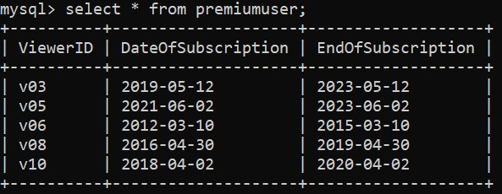
SQL SCHEMAS
Premiumuser

Slide 27
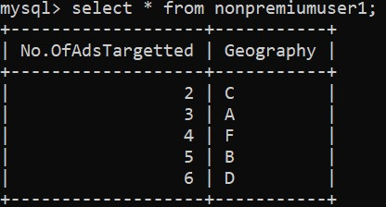
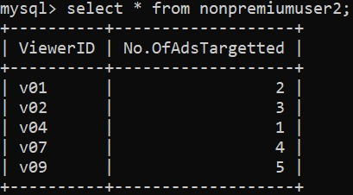
SQL SCHEMAS
nonpremiumuser2
nonpremiumuser1

Slide 28
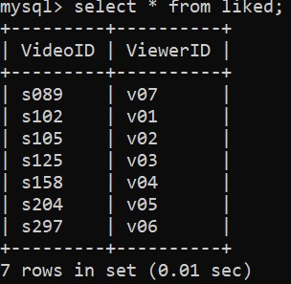
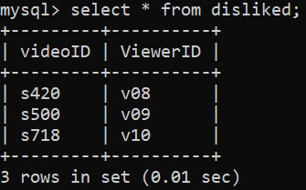
SQL SCHEMAS
Disliked
Liked

Slide 29
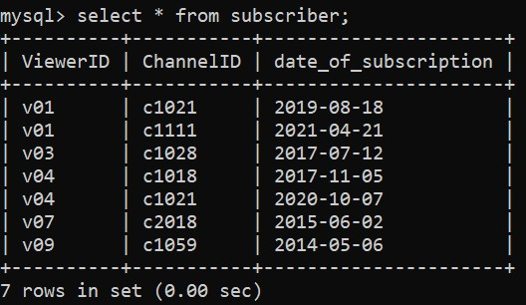
SQL SCHEMAS
subscriber

Slide 30
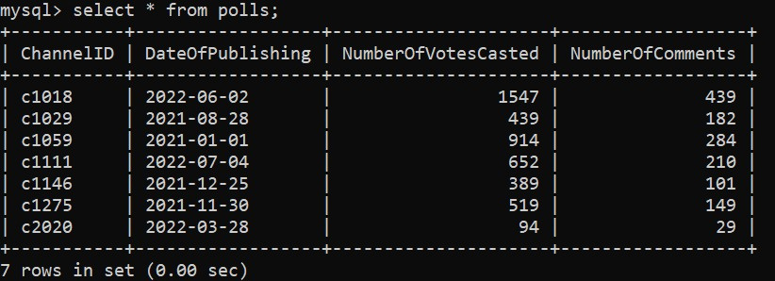
SQL SCHEMAS
polls

Slide 31
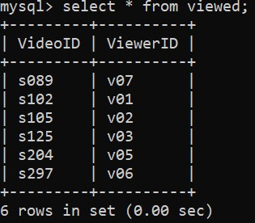
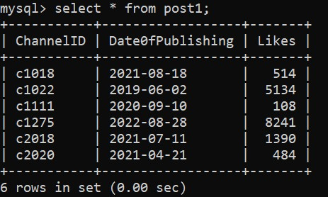
SQL SCHEMAS
post1
viewed

Slide 32
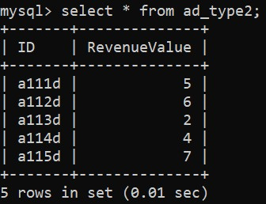
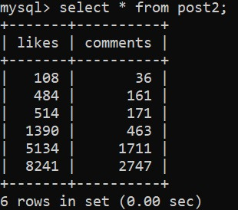
SQL SCHEMAS
post2
ad_type2

Slide 33
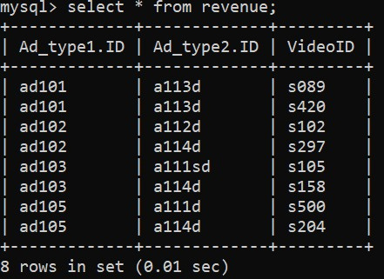
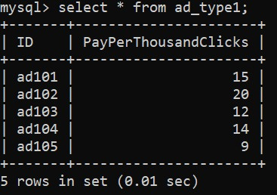
SQL SCHEMAS
ad_type1
revenue

Slide 34
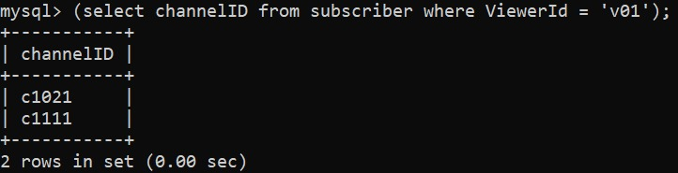
SQL QUERIES
1. DISPLAY CHANNEL ID OF ALL CHANNELS WHICH ARE SUBSCRIBED
BY THE VIEWER V01

Slide 35
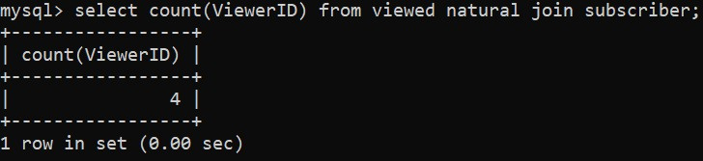
SQL QUERIES
2. NUMBER OF VIEWERS WHO ARE ALSO SUBSCRIBERS

Slide 36
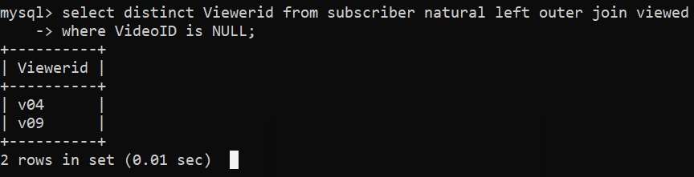
SQL QUERIES
3. SELECT ALL SUBSCRIBERS WHO HAVEN'T WATCHED THE VIDEOS

Slide 37
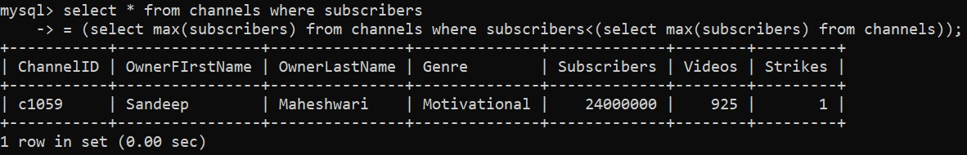
SQL QUERIES
4. DISPLAY THE DETAILS OF THE 2ND
MOST SUBSCRIBED CHANNEL

Slide 38
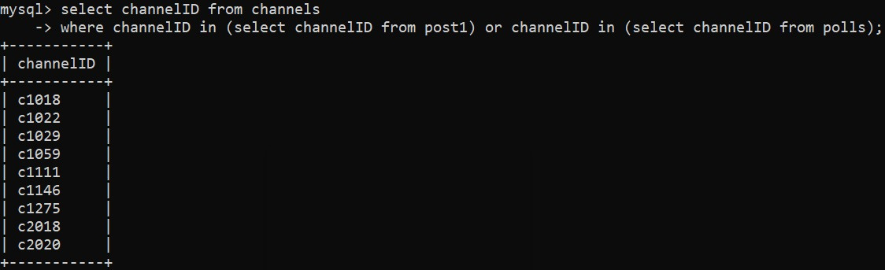
SQL QUERIES
5. SELECT CHANNEL ID OF THOSE CHANNELS THAT HAVE ATLEAST 1 POST OR 1 POLL

Slide 39

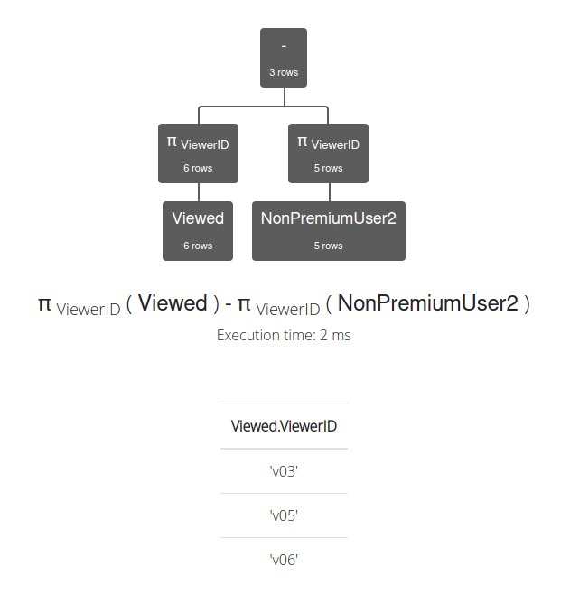
RELATIONAL ALGEBRA
List the premium users who have viewed some video.

Slide 40
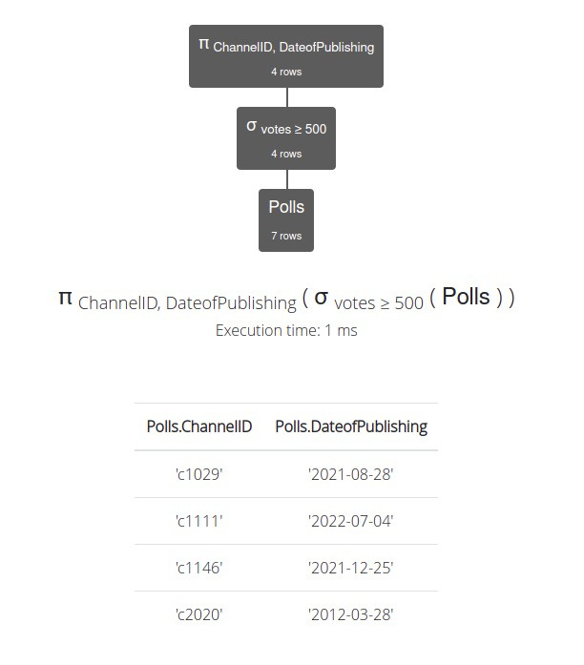
RELATIONAL ALGEBRA
2. list the polls which have greater than or equal to 500 votes casted .

Slide 41
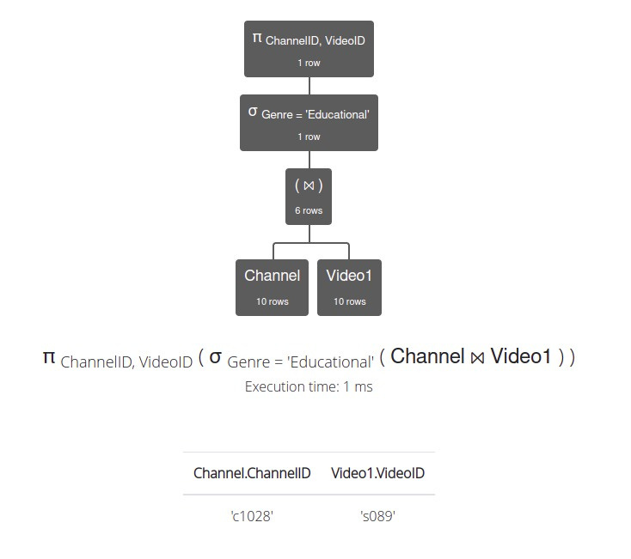
RELATIONAL ALGEBRA
3. List the video ID of the channels whose genre is Educational.

Slide 42
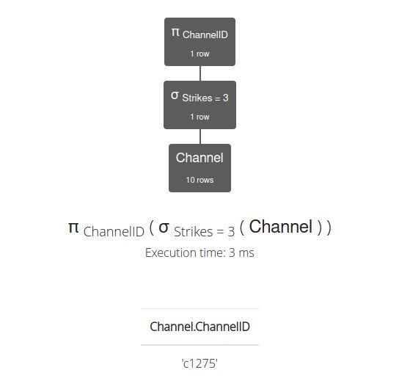
RELATIONAL ALGEBRA
4. List the channels to be terminated.

Slide 43
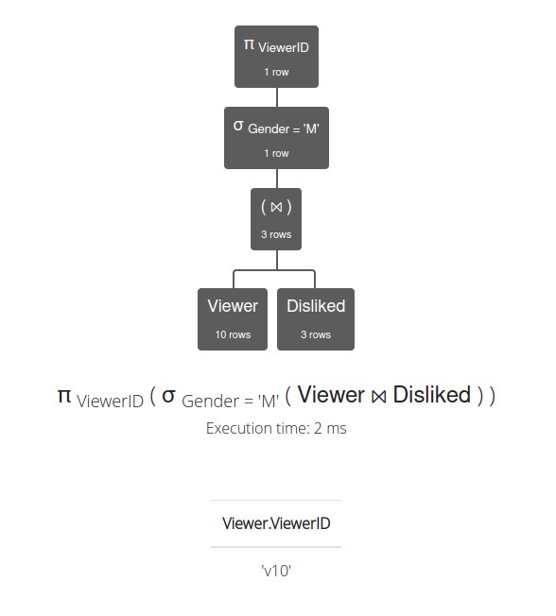
RELATIONAL ALGEBRA
5. List the viewers ID whose gender is male and have disliked some video.

Slide 44

Thank You

